Slide 1
Capstone Project Presentation
Machine Learning | Dataset: Used Car (in India)
Presenting by Yvonne Gan

Slide 2
Problem Statement
The popularity of used cars is rising, over new cars in India. This could be due to the economic downturn that caused by the Pandemic which resulted buying the new car is much more unaffordable by people.
Consumers manually bring their cars down to workshops to estimate the selling price of their used cars. This process requires a lot of time and resources.

Slide 3
Mission
Analysis and identify the factors that potentially influence the used cars price
Build a prediction model which can automatically help new car-sellers better and efficiently suggesting suitable price to list their used cars at based on the features.

Slide 4
The workflow for the solutions
Data Understanding
Data Cleaning
Visualization/ EDA
Data Pre-processing
ML Model building
Understanding and exploring the Data
Basic explanation about the data ( summary, statistic and etc.)

Slide 5
Information/ Context of the Features
Attribute | Description
Name | The brand and model of the car | 1876 different types of model
Location | The location in which the car is being sold or is available for purchase | 11 cities
Year | The year or edition of the model | 22 different years
Kilometers_Driven | The total kilometers driven in the car by the previous owner(s) in KM
Fuel_Type | The type of fuel used by the car | 5 types of Fuel
Transmission | The type of transmission used by the car | 2 categories
Owner_Type | Whether the ownership is Firsthand, Second hand or other | 4 categories
Mileage | The standard mileage offered by the car company in kmpl or km/kg | 443 types of fuel consumption records
Engine | The displacement volume of the engine in cc | 147 different types of cc
Power | The maximum power of the engine in bhp | 373 different types of house power
Seats | The number of seats in the car | Total 8 categories excl NA & Zero
New_Price | Price of new model
Price | The price of the used car in INR Lakhs

Slide 6
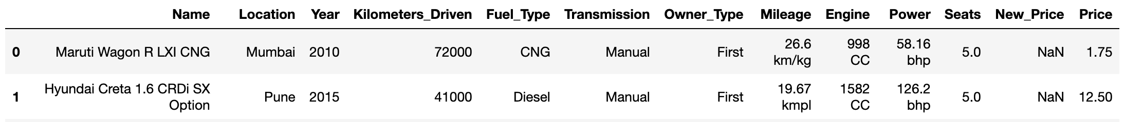
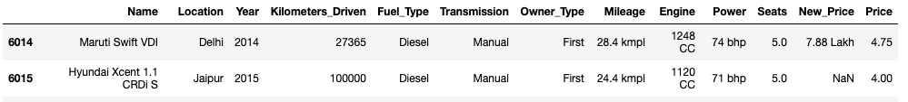
Datasets and Inputs ~Information and context of the data
Renamed columns
Top 2 rows
last 2 rows

Slide 7
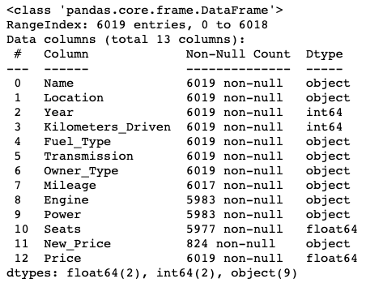
Datasets and Inputs ~Information and context of the dataset
Shape of Dataset
Rows = 6019
Columns = 13
No Duplicated data/values

Slide 8
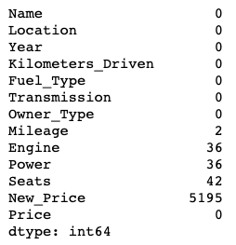
Missing Value

Slide 9
The workflow for the solutions
Data Understanding
Data Cleaning
Visualization/ EDA
Data Pre-processing
ML Model building
Removes duplicate and irrelevant data
Fix corrupted and structural data
Filter unwanted outliers and utilize useful data
Handling missing Value
Handling Outlier

Slide 10
“Name”
“Brand”
“Model”
Total 1876 unique values
Total 30 unique values
Total 1842 unique values
Consist of Car Brand and Model
New column created from “Name” column.
New column created from “Name” column.
Rename “Land” to “Land Rover”
Has same brand differentiated by upper/lowercase, changed all to lowercase for accuracy value.
Original 31 unique value, reduced to 30 after cleaning.
Many similar model were segregated by special characters. Removed all special characters and spacing to standardized.
Removed “Rover” from the beginning of model name as it belongs to “Brand”
Original 1876 unique value, reduced to 1842 after cleaning.
Split the name values into 2 different columns for better understanding of data
New Column 01: Brand
New Column 02: Model

Slide 11
“Year”
“Fuel_Consumption”
“Engine_
Power”
“Horse_
Power”
“Seat_
Capacity”
22 different years
Renamed from “Mileage”
Total 147 types, including NaN.
Total 373 types, including NaN.
Total 9 types, including NaN and a Zero value.
Year indicated the year of the car build. How can this help with the model building?
Object data type due to unit measurement. There are 5951 units is kmpl and 66 units are km/kg
Object data type due to unit measurement. 36 columns with missing values.
Object data type due to unit measurement. 36 columns with missing values.
Likely Zero is a corrupted/ human error so treating it as missing value.
It is more useful to get hypothesis of the car values based on the age of the car. Hence taking present year minus the “Year” column to get new column “Car_Age”
Split out unit measurement and only remained the numeric values.
India Gov, calculate oil as Volume rather than Mass. So converted all to kmpl.
Only 2 missing values, replaced with median.
Split out unit measurement and only remained the numeric values.
Used KNN Imputer to match and replace the missing values with their nearest similar dataset values
Split out unit measurement and only remained the numeric values.
Used KNN Imputer to match and replace the missing values with their nearest similar dataset values
Missing values aren’t high number and after inspect, found several same model cars, so researched online and replaced the missing seat capacity with actual information from network.
**After completed the data cleaning, dropped unuseful columns of “Name”, “Year” and “New_Price”.
New_Price = As this project problem statement is not about predicting of new car price so dropping this large missing value column

Slide 12
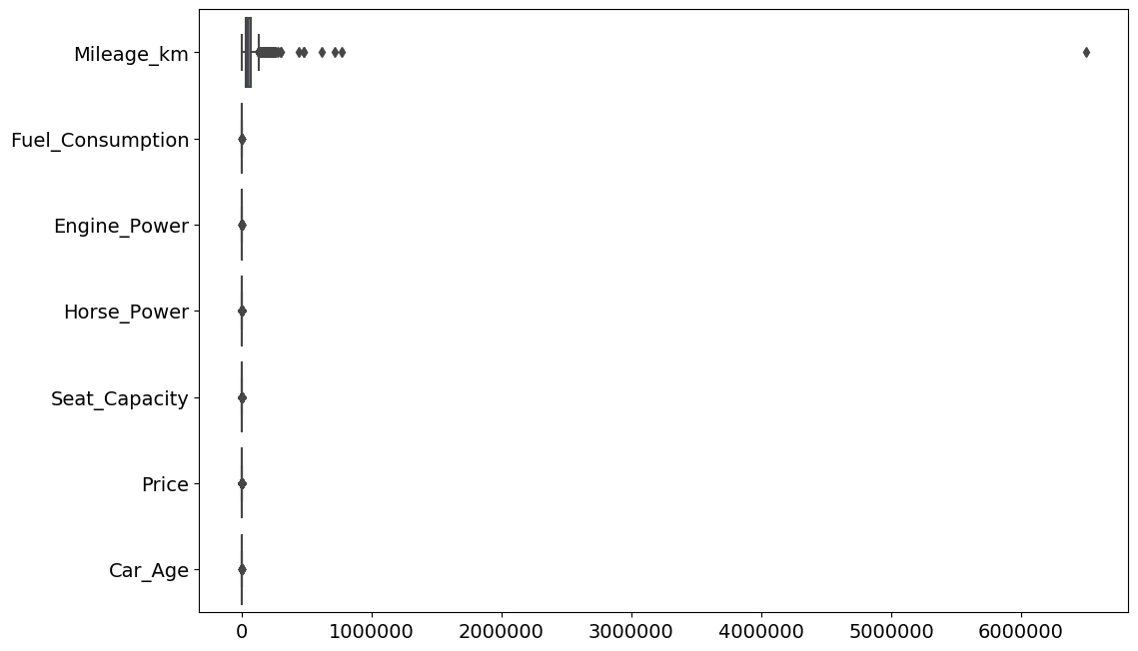
Outlier ~Before~
Data point that significantly different from other values.
One data has 6500000 Mileage km for a 3yrs old car which is very unlikely.
Notes:
six million five hundred thousand

Slide 13
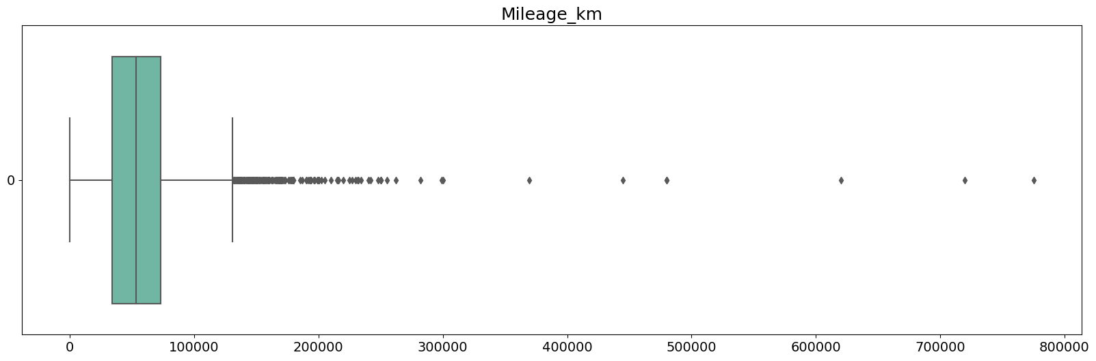
Outlier ~After~
Filtered similar car model by brand, fuel type then same car age of
3yrs old and calculate the mean value to replace with the outlier.
Notes:
eight hundred thousand

Slide 14
The workflow for the solutions
Data Understanding
Data Cleaning
Visualization/ EDA
Data Pre-processing
ML Model building
Correlation of data
Plotting
Finding insights of the data

Slide 15
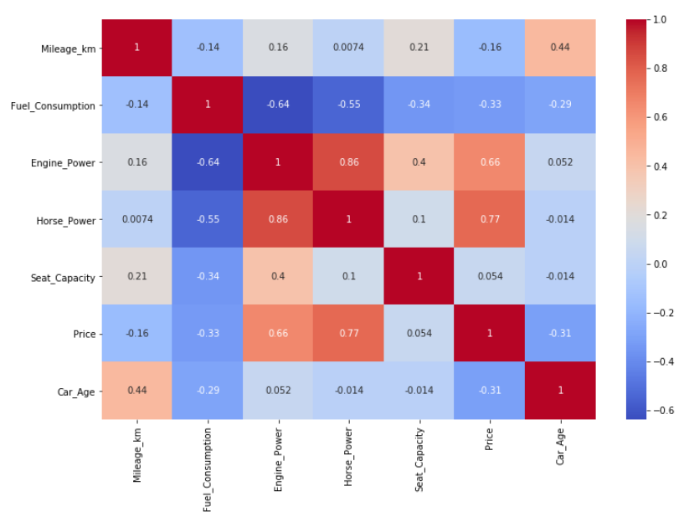
Correlation of data/features
Horse_Power has 0.77 correlation with Price.
Horse_Power has 0.86 correlation with Engine_Power.

Slide 16
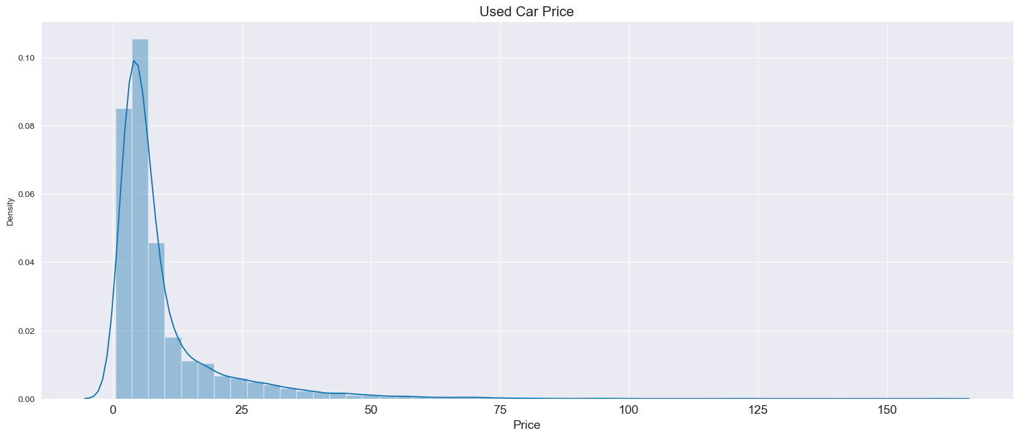
Distribution of Used Car Price
From the above distplot, majority of the used car price is between 0 to 25 Lakhs

Slide 17
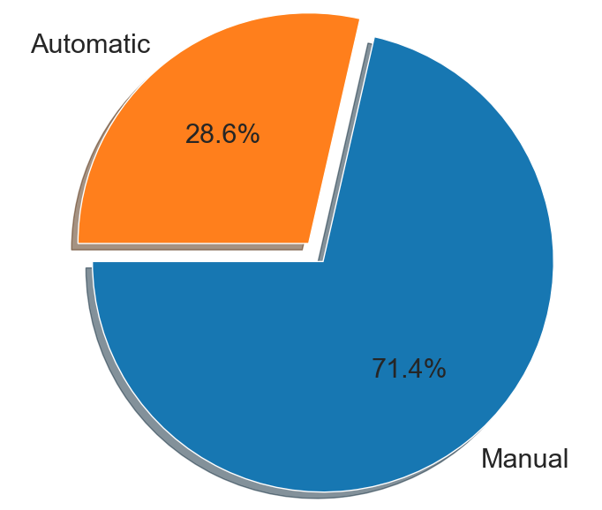
Car Transmission Types
1720
There are close to 72% of Manual Car in the dataset, genuinely Manual Car is more common as the pricing is comparatively cheaper than Automatic Car therefore it is a more affordable choice of car transmission in India.
4299

Slide 18
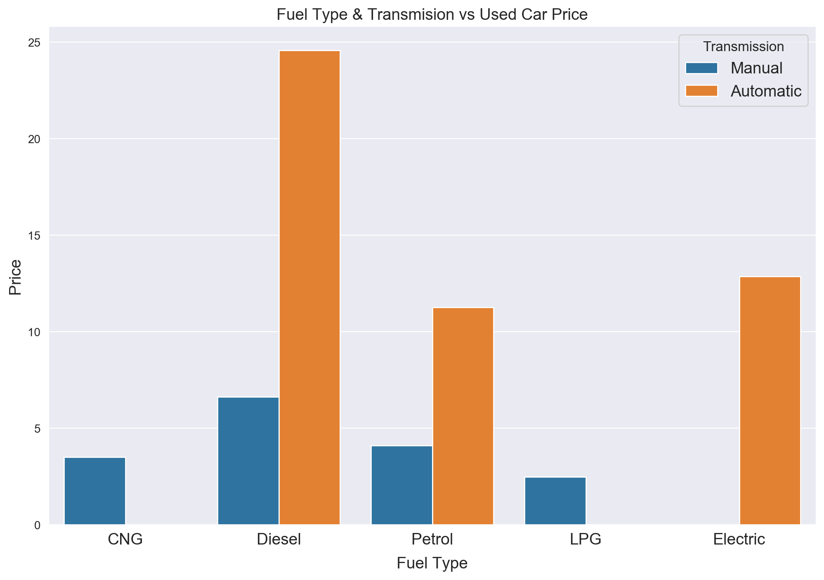
Fuel Type & Transmission vs Used Car Price
Automatic car on Diesel has tremendous higher end of the price.
This could either mean with genuinely Automatic car price is higher with add-on by the diesel prices, or the amount of Automatic car in India isn’t much and on top of it the diesel fuel pricing relatively raised the car price.

Slide 19
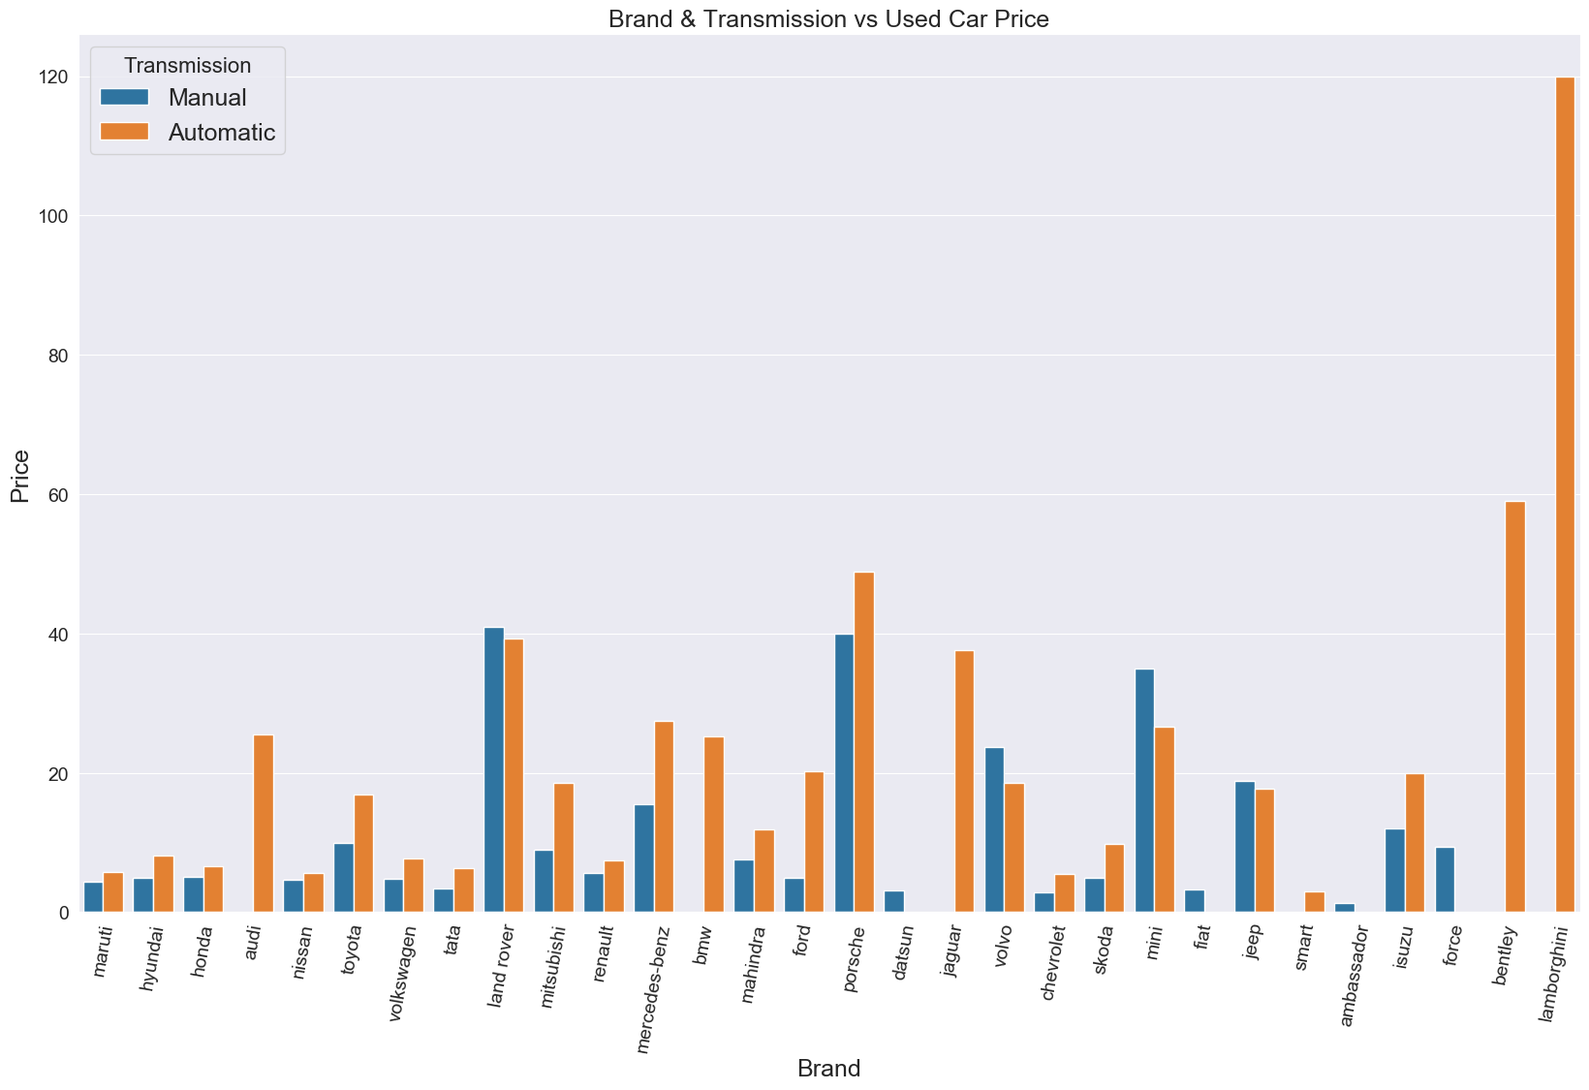
Brand & Transmission vs Used Car Price
Undeniably, most of the high end pricing, brands are luxury brands or foreign brands.
Whereas some of the local brands in India - Maruti or Tata is on the most affordable price range.

Slide 20
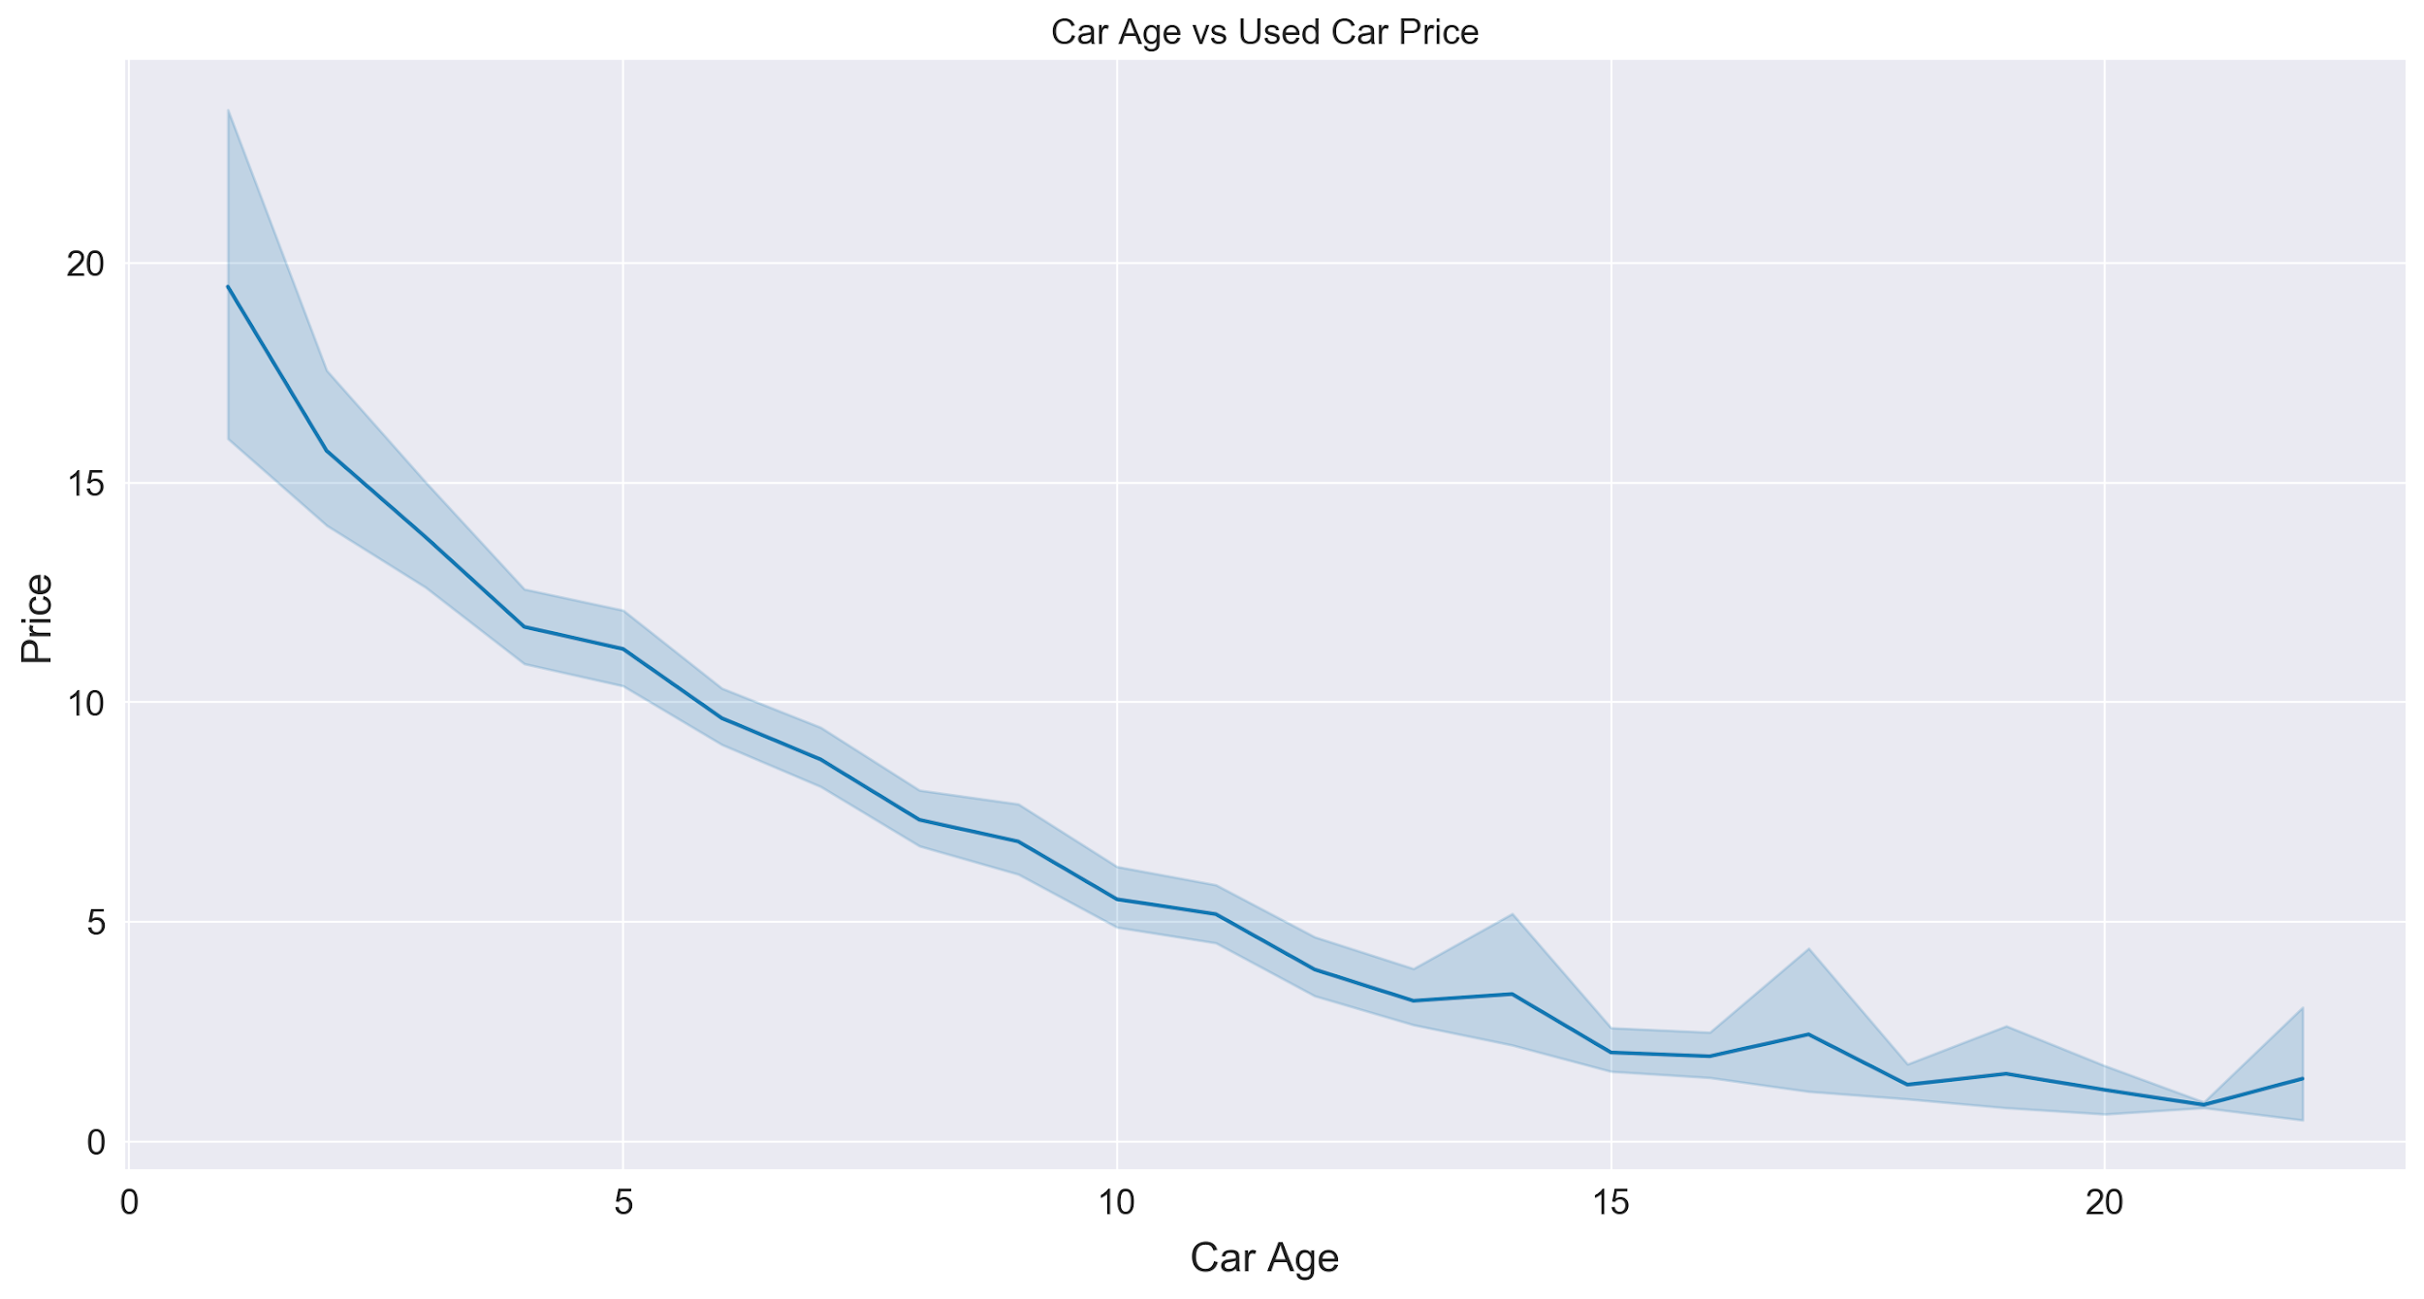
Car Age vs Used Car Price
The older the car age is, the price decrease massively.

Slide 21
The workflow for the solutions
Data Understanding
Data Cleaning
Visualization/ EDA
Data Pre-processing
ML Model building
Feature Engineering
(Encoding, Scaling etc.)
Feature Split

Slide 22
Feature Split
Best Practice:
To minimize Data Leakage, splitting dataset before encoding
Split dataset to 70% train set and 30% test set
Splitting dataset to Train and Test Set

Slide 23
Feature Encoding
01
Fuel_Type: Encoded to 5 new columns
Transmission: Encoded to 2 new columns
Location: Encoded to 11 new columns
Get Dummies
(For straight forward categorical values)
02
"No_of_Owner" is high chance a ranking categorical values
Encoded into 4 category values
First : 0.0
Second : 1.0
Third : 2.0
Fourth & Above: 3.0
Ordinal Encoding
03
Applied on “Brand” and “Model” as they are occurance of categorical values in this dataset
Frequency Encoding

Slide 24
The workflow for the solutions
Data Understanding
Data Cleaning
Visualization/ EDA
Data Pre-processing
ML Model building
Explore Regression Algorithms
Training and Prediction of Dataset
Validation
Evaluation
Feature Importance

Slide 25
Project Design
Based on the dataset provided and task assign to do prediction on used car pricing, multivariate regression algorithms under supervised learning will be best used on this scenario.
As Regression is used for predicting the occurrence of an event depending on the degree of association of variables.
Therefore considering regression algorithms such as Linear Regression, XGBoost, SVM, Random Forest and etc.

Slide 26
The ML Process - Approaches applied for this dataset
Finalized Model
Used top 5 importance features and train with the selected best model to finalize if the model is robust.
1
Feature Importance
Using selected best model to find the importance features for this model/dataset.
2
Tuning Process
Apply Tuning method - Cross Validation/ GridSearch CV to further tuning the model and observe the improvement.
3
Training on Test Set
Selected top 3 best scoring models and train with test set to further identify the best model(s).
4
Training on Train Set
Training on Train Set for the 7 selected Regression Models - Linear Regression, Support Vector Machine(Regression), XGBoost, Random Forest Regression, Lasso, Ridge and ElasticNet.
5

Slide 27
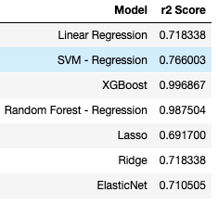
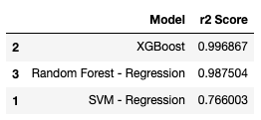
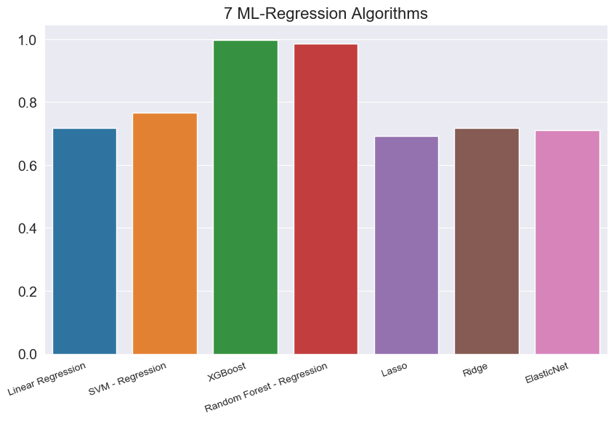
Model Selection
Based on the above accuracy scoring, selected top 3 models to next steps.
7 ML Regression algorithms and the scoring to identify their accuracy.
The 7 ML algorithms started with and the scoring based on training on Train set.
Based on that, selected the top 3 models to further exploration.
Using R-squared as the metrics as it determines how well the model fits the dependent variables.

Slide 28
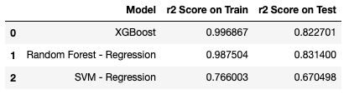
Train on Test Set
Using the selected 3 models and train with the test set to see the accuracy.
As we can see, the scoring on Test set dropped drastically but XGBoost and Random Forest - Regression are still pretty high, above 80%.

Slide 29
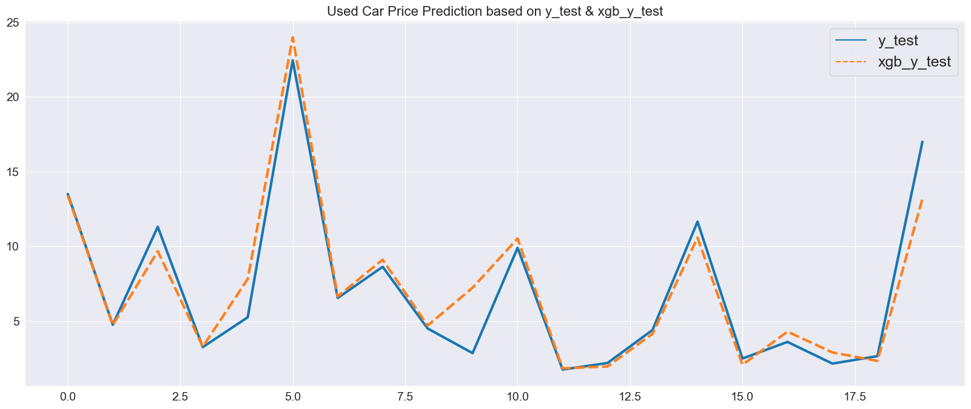
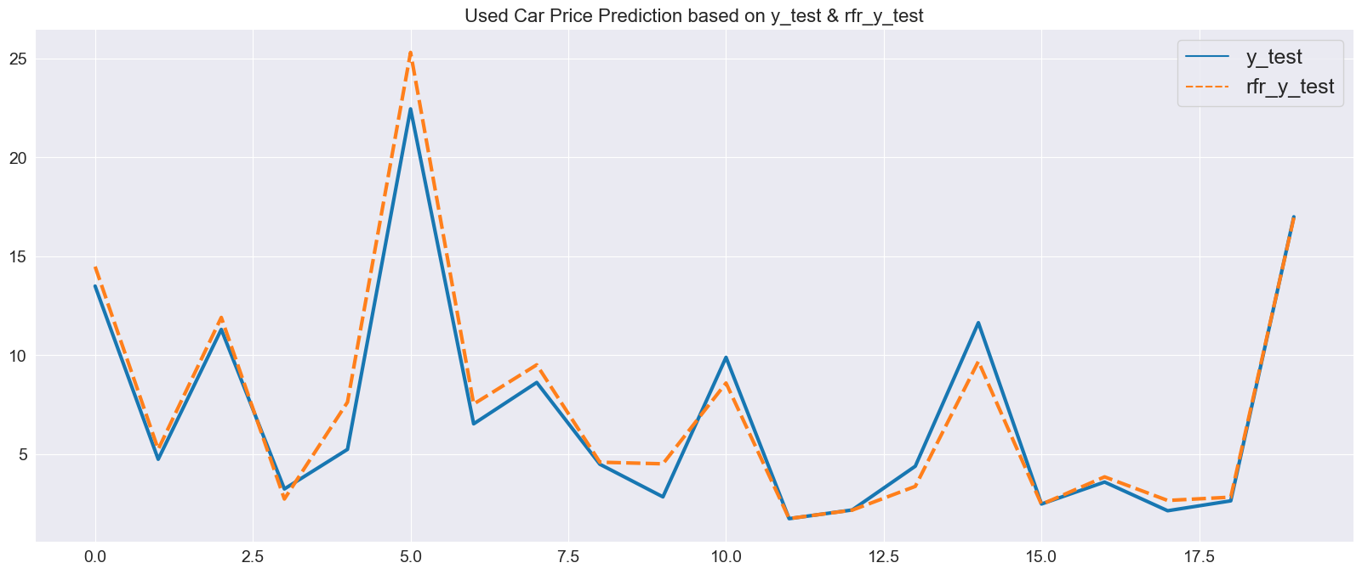
Models Performance
on prediction of
used car price
over Test set
XGBoost
Random Forest (Regression)

Slide 30

Cross Validation
~GridSearch CV ~
This method gathers all the possible combinations of parameter values are evaluated and retained the best combination
Random Forest- Regression dropped further on the CV yet XGBoost actually improved.
With that, I decided to drop Random Forest- Regression from the process and focus on XGBoost on next steps.

Slide 31
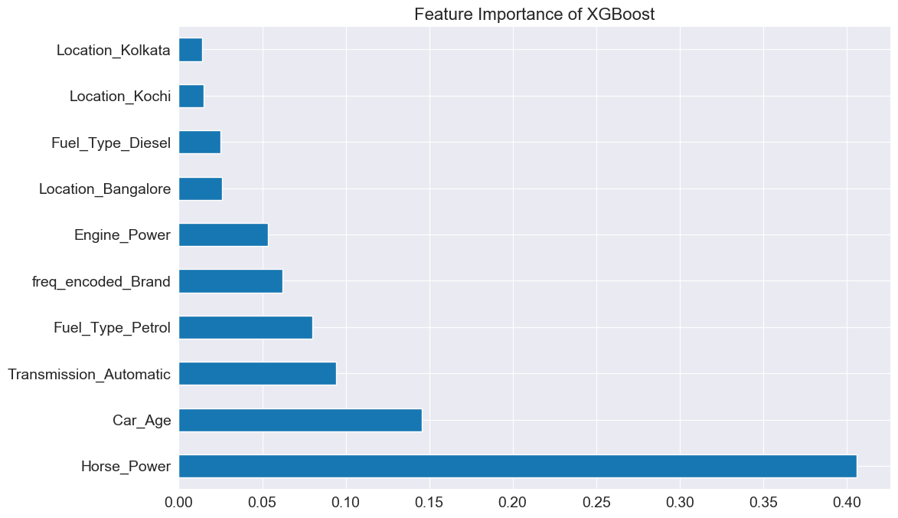
Feature Importance
From the results, here are some insights on the top 5 features.
a) Horse_Power:
The higher horsepower the better performance and speed it is for the car.
b) Car_Age:
The newer the car, the lesser potential issues compare to older cars. It can be very importance to Buyers.
c) Automatic:
Increasingly demands and popularity in market recent years and Automatic car allows driver to be more comfortable to control during the concentrated traffic in India.
d) Petrol:
Petrol is the most easier and common fuel type majority in the world and relatively cheaper than other fuel type.
e) Brand:
Car brand is developed over time depending on characteristics like product quality, performance, endorsements, and ownership satisfaction.

Slide 32

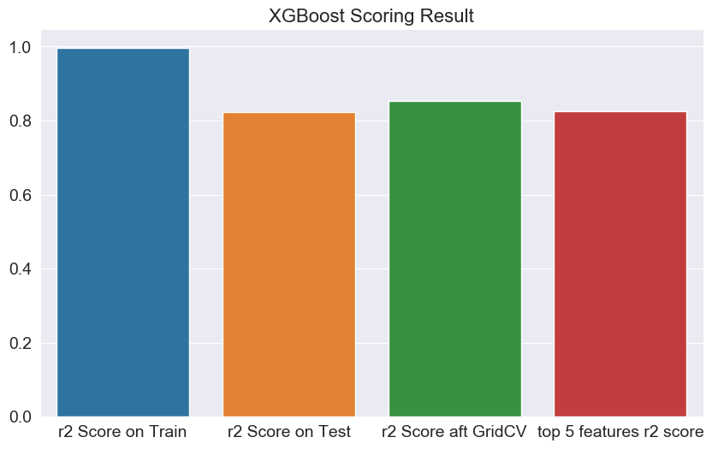
80%
Despite the scoring dropped, XGBoost is still the best model for this dataset as it get at least 80% above on the results on all the tests.

Slide 33
Conclusion
Car Sellers will able to identify and determine the values of used car that brought down to their workshop by consumers with the help of this ML model.
This will help to reduce their time on manual process and increase the efficiency on appraises.

Slide 34
Thank you! :)
Q & A

